Slide 1
Memory Management Module 5
Operating Systems
Nadia Qureshi

Slide 2
Chapter Outline
Memory
Memory hierarchy
Process loading and swapping
Memory management
Memory allocation methods
Storage management strategies
Contiguous memory allocation
Non-contiguous memory allocation
Paging
Simple paging
Implementation of paging
Segmentation
Simple segmentation
Segment addressing

Slide 3
Memory
Used for storage and retrieval of data and instructions
Essential component
Logically memory system can be divided into three groups
Internal memory
Set of registers in processor
they hold temporary results during execution
Main memory
Communicates directly with CPU
Secondary (external memory)
Peripherals storage devices such as disk and tape etc

Slide 4
Memory
Memory performance largely depends upon
The organization of memory
Storage capacity
Speed of memory system

Slide 5
Memory Hierarchy
Registers
Cache
Main memory
Magnetic disk
Magnetic tape
Capacity
Speed & Cost

Slide 6
Memory Hierarchy
Registers
are fastest, smallest and most expensive
Main memory
It is principal memory
It is generally extended with a higher speed smaller cache
Used to improve movement of data between main memory and processor registers
Usually not visible to user or programmer or indeed to the processor
External devices are permanent storage
Also referred as secondary or auxiliary memory
e.g. magnetic disk, tape, hard disk

Slide 7
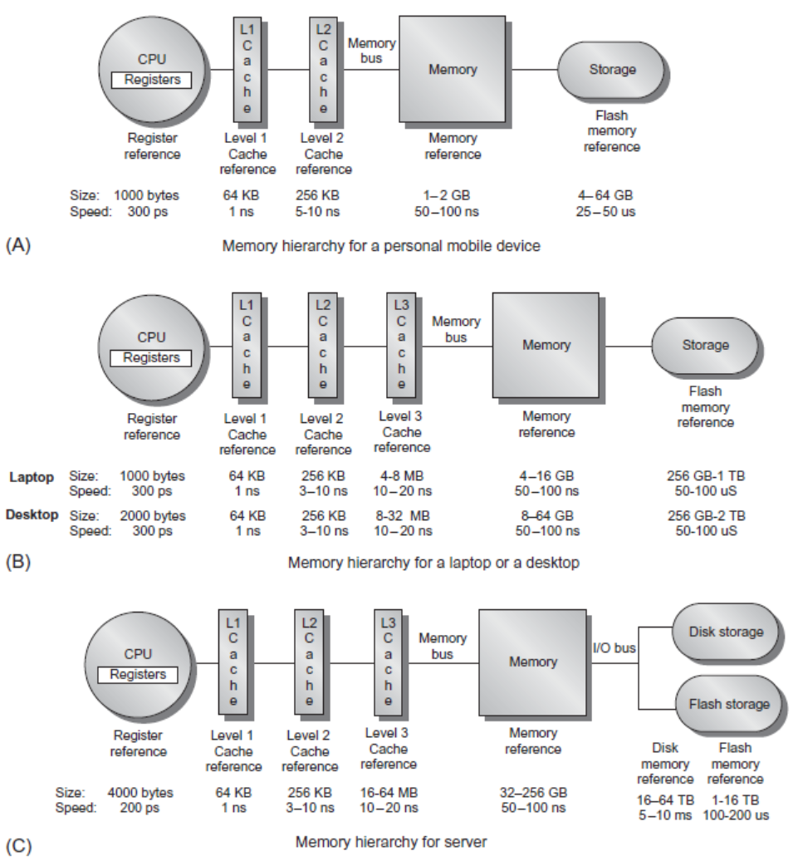
Memory Hierarchy

Slide 8
Process Loading & Swapping
Process loading
Transfer of a process from secondary storage to main memory
Process Swapping
Transfer of a process from memory to secondary storage

Slide 9
Memory Management
Memory is a volatile array of words or bytes, shared by the CPU and I/O devices
Programs must be brought into memory and place in form of a process to be executed
The operating system manages the memory activities
Keep track of which parts of memory are currently being used and by whom
Decides which process(s) to load when memory space becomes available
Allocate and de-allocate memory space to processes as required

Slide 10
Memory Management
In a uni-programming environment, main memory is divided into two parts
for operating system
for the user programs currently being executed
In a multiprogramming environment, the user part is further subdivided into sub-parts to accommodate several processes
The task of sub-division of memory to pack as many processes is carried out dynamically by the memory manager and is called memory management
Memory manger is part of operating system

Slide 11
Duties of Memory Manager
Execute maximum processes at the same time
Provide satisfactory level of performance
Sharing of memory space between processes
Protect each process from other
Transparent addressing of memory space for programmers

Slide 12
Memory Management Problems
Problems which can arise at programmer’s level
Insufficient main memory available; for a program plus its data
The programmer must engage in a practice known as overlaying
Keep in memory only those instructions and data that are needed at any given time
Needed when process is larger than amount of memory allocated to it
In this program and data are organized in various modules which can be assigned the same region of memory, with a main program responsible for switching modules in and out as need
In a multiprogramming environment, programmer does not know how much space will be available or where the space will be

Slide 13
Address Binding
Address binding is the mapping of the processor view of memory to the physical memory locations
Typically occurs at one of three stages
Compile time
Load time
Execution time

Slide 14
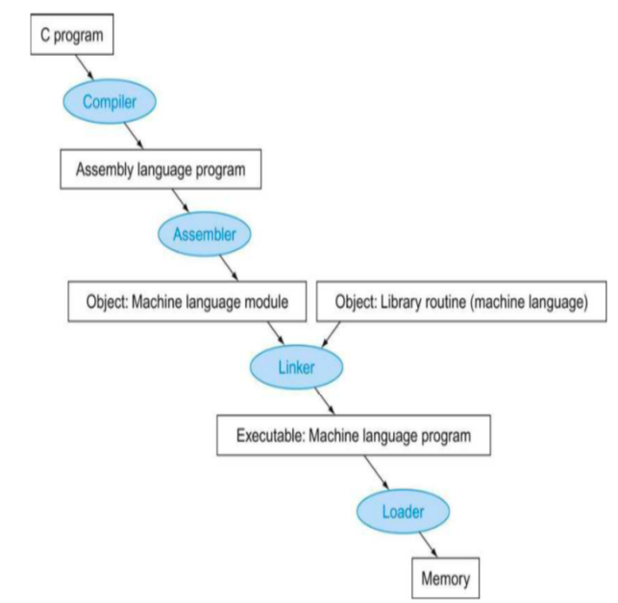

Slide 15
Address Binding
Compile time
If memory location is known priori, absolute code can be generated
Must recompile code if starting location changes
Load time
Must generate re-locatable code if memory location is not known at compile time
Execution time
Binding delayed until run time if process can be moved during its execution from one memory segment to another
Need hardware support for address mapping

Slide 16
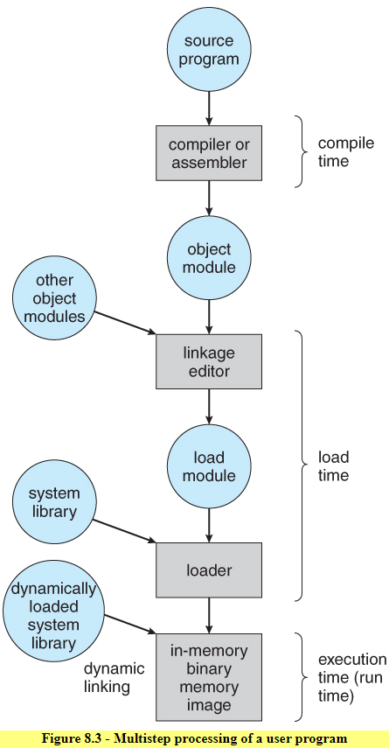

Slide 17
Logical vs. Physical Address Space
Logical address
Generated by CPU
Also referred to as virtual address
Physical address
Address seen by the memory unit
Compile and load time binding
Logical = physical memory
Execution time binding
Logical is virtual memory, i.e. does not necessarily coincide with physical memory

Slide 18
Virtual Addresses
There exist a set of memory addresses that programs can produce
These program generated addresses are called virtual or logical addresses and form virtual address space
Physical addresses are the addresses seen by the memory unit
Logical and physical addresses are same at compile time
Logical and physical addresses differ in execution time

Slide 19
Memory Management Unit
Hardware device that maps virtual address to physical address
Use a base or relocation register
The value in relocation register is added to every address generated by a user process at the time it is sent to memory
The user programs deals with logical addresses
It never sees the real physical addresses

Slide 20
Memory Management Unit
On computers without virtual memory, the virtual addresses are put directly onto memory bus
When virtual memory is used, the virtual addresses do not go directly to memory bus
Instead, they go to memory management unit (MMU)
MMU is a chip or collection of chips that converts the virtual addresses onto the physical memory addresses
The user program deals with logical addresses
it never sees the real physical addresses

Slide 21
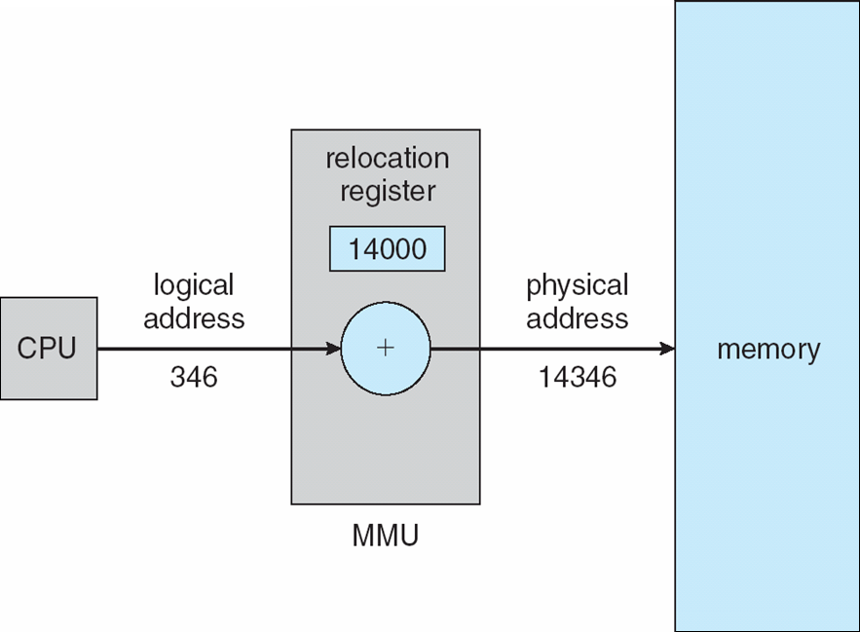
Memory Management Unit

